Slide 1
Android | Beginner
Review Pre Training
Git & Using Git
Android Project Structure
Android User Interface
Activity
Intent
Fragment
Ade Rifaldi

Slide 2
Review Pre Training

Slide 3
Git

Slide 4

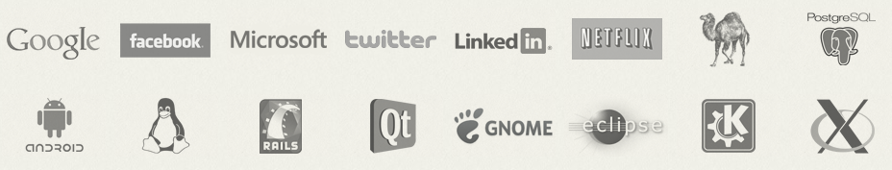
Git
"Git is a free and open source distributed version control system designed to handle everything from small to very large projects with speed and efficiency." https://git-scm.com

Slide 5
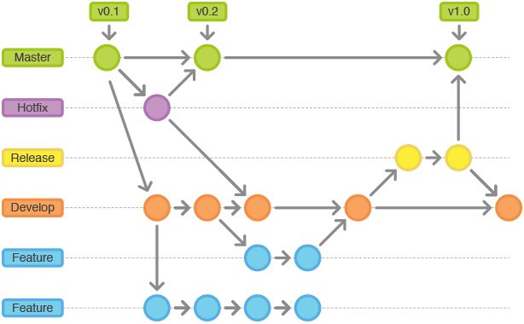
Branch

Slide 6




Slide 7
Using Git (Github)

Slide 8
Commit, Push, & Pull
Commit
comment any changes of your source code.
Push
save your changed source code to remote repository.
Pull
get your changed source code from remote repository to local repository.

Slide 9
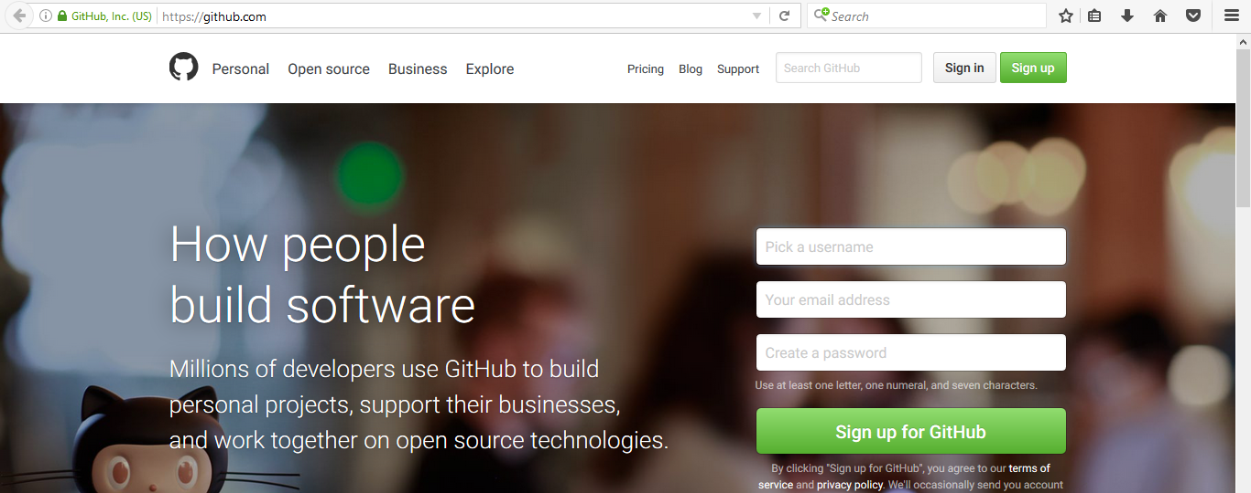
Github
Free

Slide 10
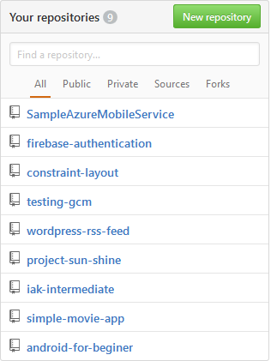
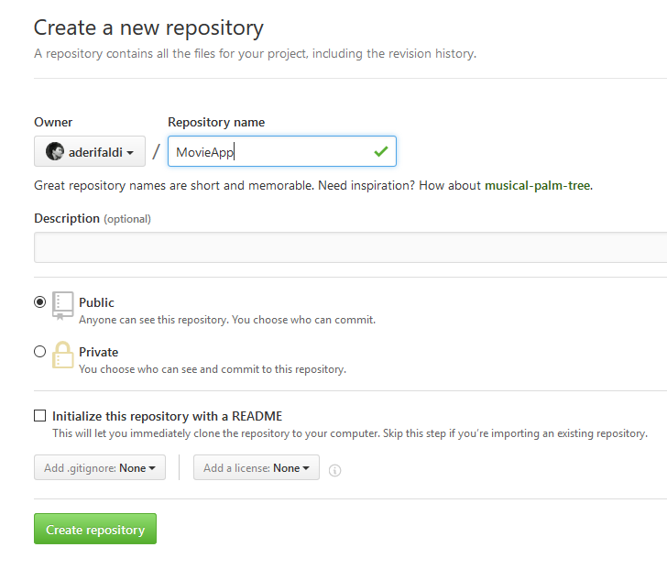
Create Repository
content

Slide 11
Android Project Structure

Slide 12
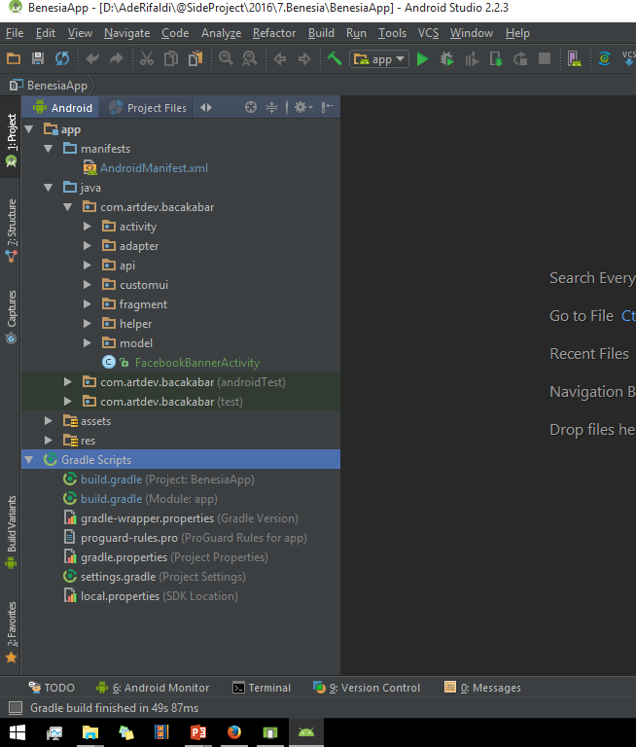
app
manifest
java
assets
res
gradle
gradle.project
gradle.app

Slide 13
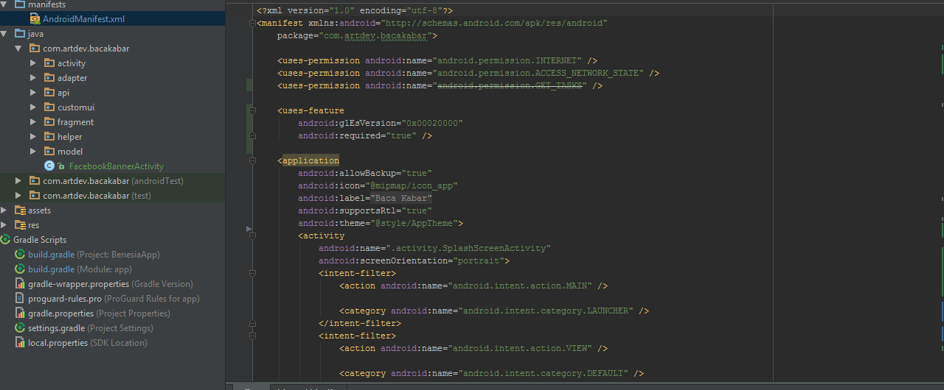
manifest
Describes the nature of the application and each of its components.

Slide 14
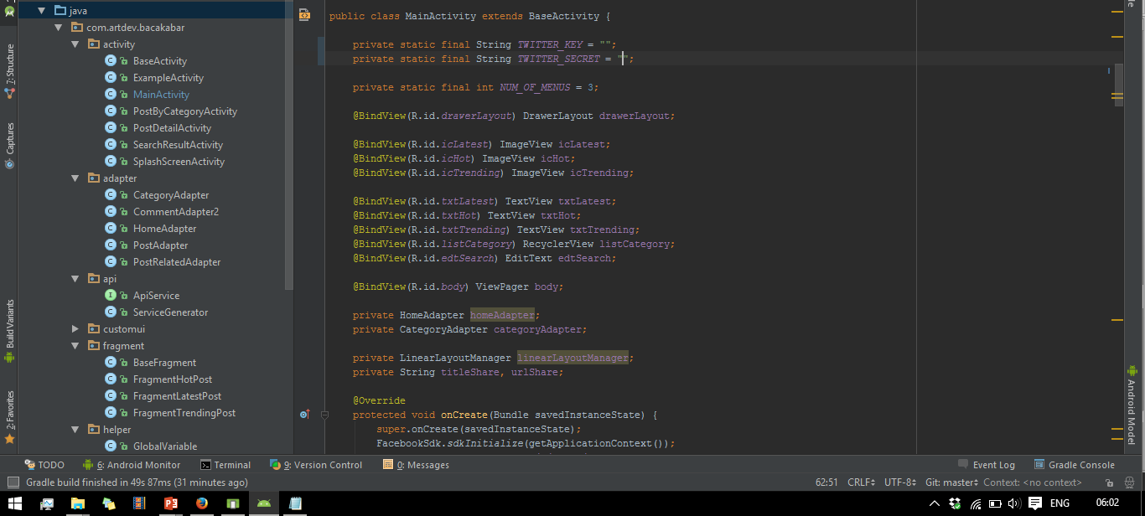
java
Contains the Java source code files, separated by package names.

Slide 15
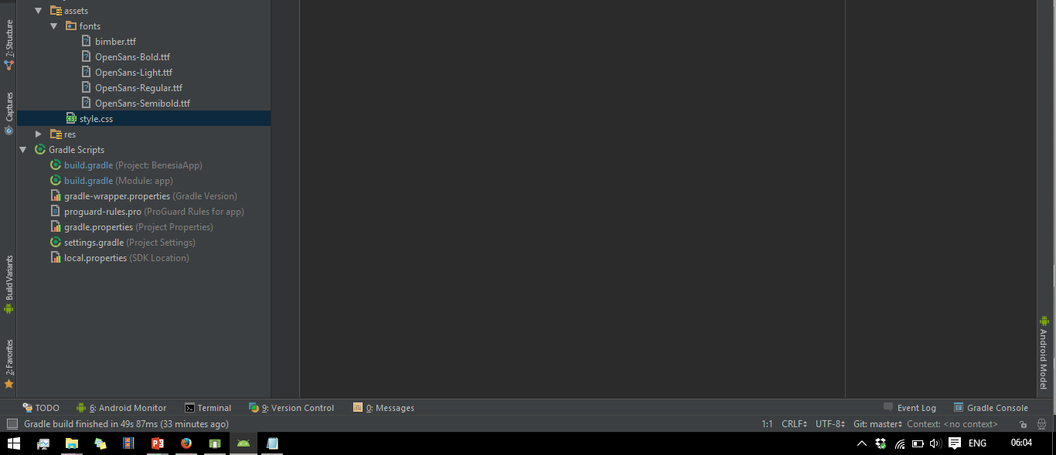
assets
Contains file that should be compiled into an .apk file as-is. You can navigate this directory in the same way as a typical file system using URIs and read files as a stream of bytes using the AssetManager.

Slide 16
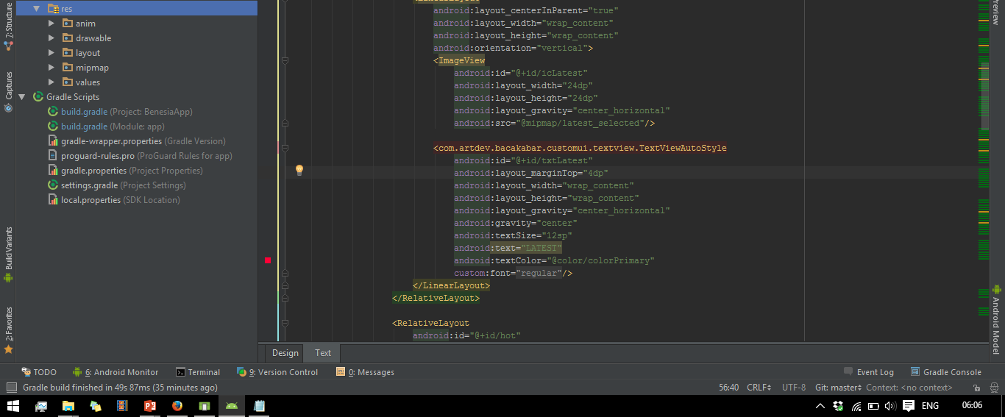
res
Contains application resources, such as drawable files, layout files, and UI string.

Slide 17
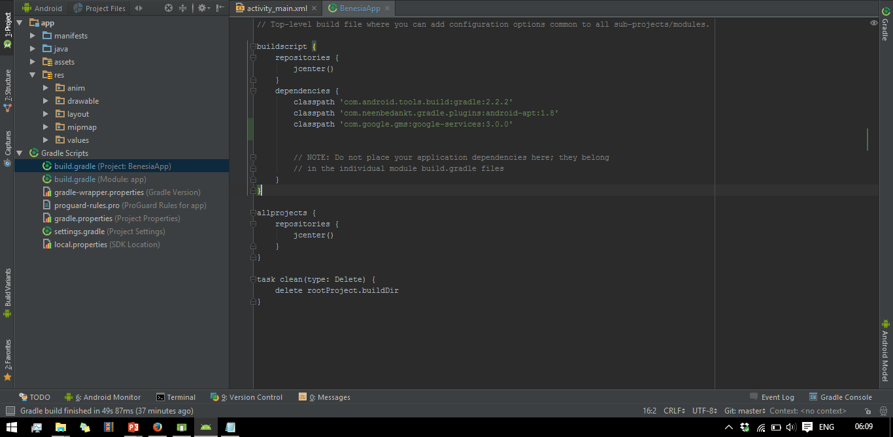
build.project
This defines your build configuration that apply to all modules. This file is integral to the project, so you should maintain them in revision control with all other source code.

Slide 18
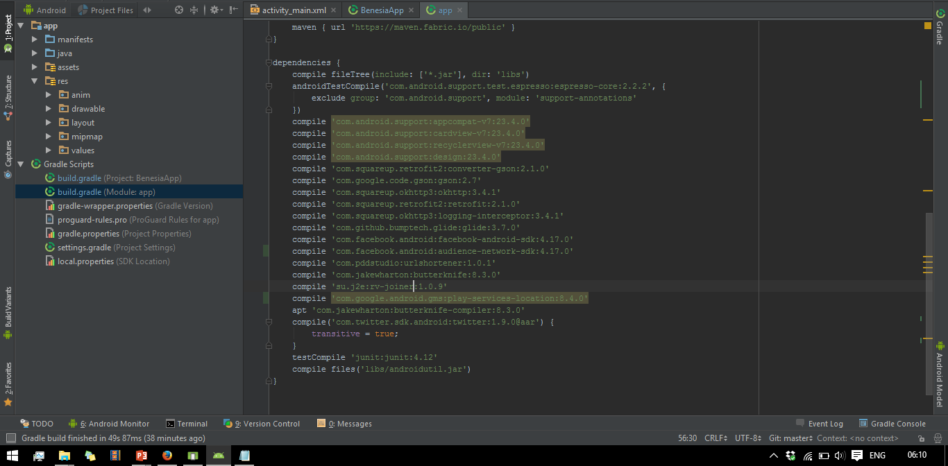
build.app
This defines the module-specific build configurations.

Slide 19
Android User Interface

Slide 20
View
This class represents the basic building block for user interface components. A View occupies a rectangular area on the screen and is responsible for drawing and event handling. View is the base class for widgets, which are used to create interactive UI components (buttons, text fields, etc.). @developer.android.com
We can: Set Properties, Set Focus, Set Up Listeners, Set Visibility.
If you want to Code the view in Java, you must give the view an "id"
android:id="@+id/my_button"

Slide 21
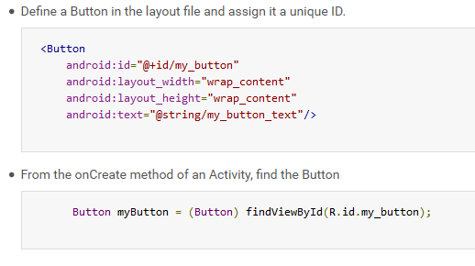

Slide 22
ViewGroup
ViewGroup (parent) is a special view that can contain other views (called children.) The view group is the base class for layouts and views containers. This class also defines the ViewGroup.LayoutParams class which serves as the base class for layouts parameters. @developer.android.com
RelativeLayout, LinearLayout, ConstraintLayout.

Slide 23
Exercise | Simple Login Layout

Slide 24
Constraint Layout
https://developer.android.com/training/constraint-layout/index.html#add-a-constraint
When creating constraints, remember the following rules:
Every view must have at least two constraints: one horizontal and one vertical.
You can create constraints only between a constraint handle and an anchor point that share the same plane. So a vertical plane (the left and right sides) of a view can be constrained only to another vertical plane; and baselines can constrain only to other baselines.
Each constraint handle can be used for just one constraint, but you can create multiple constraints (from different views) to the same anchor point.

Slide 25
Exercise | Login Layout

Slide 26
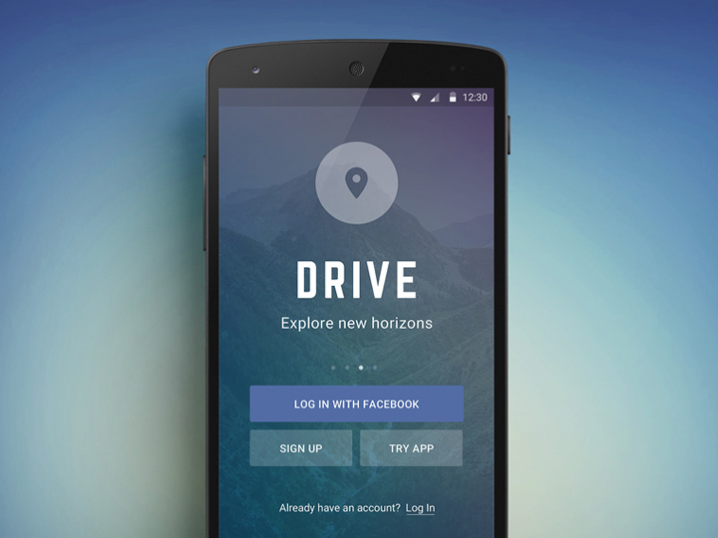

Slide 27
Activity

Slide 28
Activity
An activity is a single, focused thing that the user can do.
Almost all activities interact with the user, so the Activity class takes care of creating a window for you in which you can place your UI with setContentView(View).
Extend Activity class.
Almost all activity has layout (.xml)
An Activity has lifecycle in memory.
An Activity must registered in AndroidManifest.xml
Stack (Last In First Out)

Slide 29
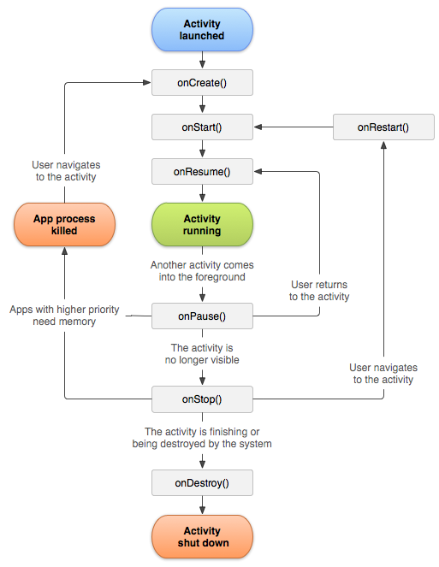
Activity Lifecycle
Activity has lifecycle in memory. Developer have understand when an Activity created (onCreate) and when an Activity destroyed (onDestroy)
Notes:
onCreate( Bundle )
Method ini dipanggil ketika aktifitas pertama kali dimulai. Kita dapat menggunakan method ini untuk melakukan inisialiasi awal seperti menentukan antar muka ( user interface ), Method onCreate( ) yang memiliki satu parameter yang dapat bernilai null atau bernilai informasi dari state sebelumnya yang dijalankan oleh method onSaveInstanceState( ).
onStart( )
Method ini mengindikasikan aktifitas yang siap ditampilkan ke user.
onResume( )
Method ini dipanggil ketika aktifitas anda dinyatakan siap ber interaksi dengan user. Ini adalah aktifitas yang paling tepat untuk menyertakan animasi dan music pada aplikasi anda.
onPause( )
Method ini dijalankan ketika aktifitas akan dijalankan di background, biasanya terjadi ketika aktifitas berjalan di atas aktifitas ini. Pada state ini sebaiknya anda implementasi persistent data pada program anda, seperti ketika sebuah database sedang dilakukan proses edit.
onStop( )
Method ini dipanggil saat aktifitas anda tidak bisa dilihat lagi oleh user dan tidak dibutuhkan untuk sementara waktu. Jika memori dalam keadaan parah (karena banyak resource berjalan) maka method onStop() tidak pernah akan dipanggil ( system mungkin akan mematikan prosesnya )
onRestart( )
Jika method ini dipanggil , berarti aktifitas anda sedang di tampilkan ulang ( redisplay) oleh user dari sebelumnya di stop.
onDestroy( )
Method ini dipanggil sebelum sebuah aktifitas di matikan ( di-destroy). Jika resource memory ketat method onDestroty() tidak pernah akan dipanggil ( system mungkin akan mematikan prosesnya )

Slide 30
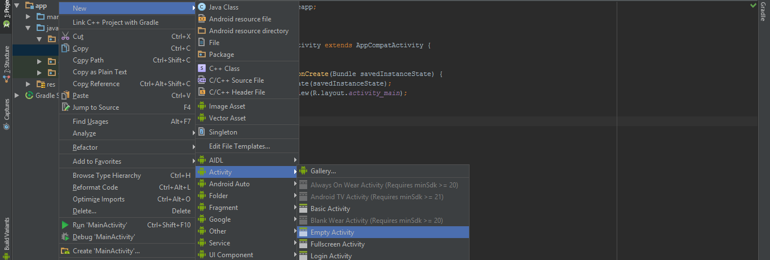
Easy Way to Create Bundling Activity
Right click – New – Activity – Empty Activity

Slide 31
Exercise | Simple Calculator

Slide 32
Intent

Slide 33
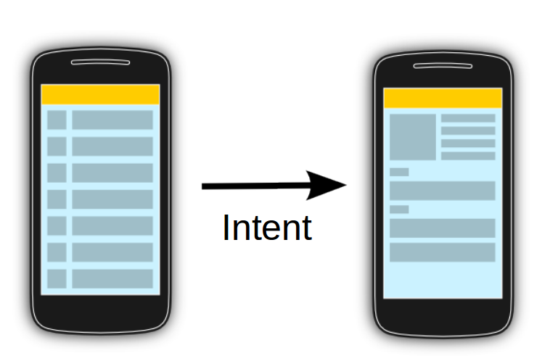
Intent
Intents allow you to interact with components from the same applications.
(explicit intent)
Intents are asynchronous messages which allow application components to request functionality from other Android components.
(implicit intent)

Slide 34
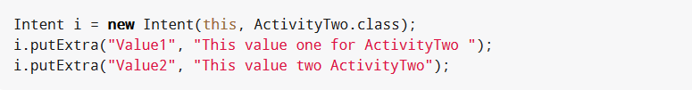
Explicit Intent
Explicit intents explicitly define the component which should be called by the Android system, by using the Java class as identifier.

Slide 35
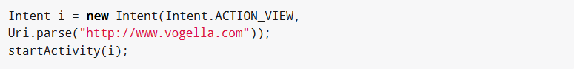
Implicit Intent
Implicit intents specify the action which should be performed and optionally data which provides content for the action. If an implicit intent is sent to the Android system, it searches for all components which are registered for the specific action and the fitting data type.

Slide 36
Exercise | Simple Navigation

Slide 37
Fragment

Slide 38
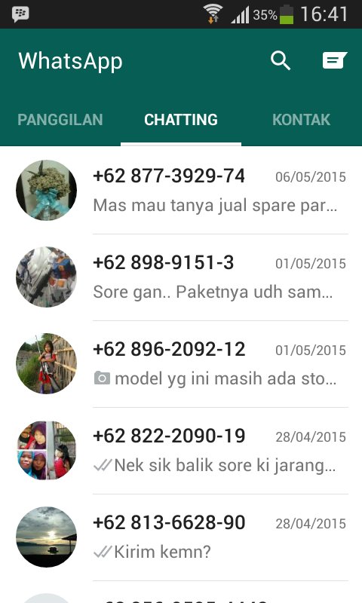
Fragments
Fragment is part of User Interface in an Activity
It contains callback methods similar to an activity, such as onCreate(), onStart(), onPause(), and onStop()
Reusable
Fragments can called in one Activity
Extend Fragment class
Like Activity, fragment has lifecycle
No need registered in AndroidManifest.xml

Slide 39
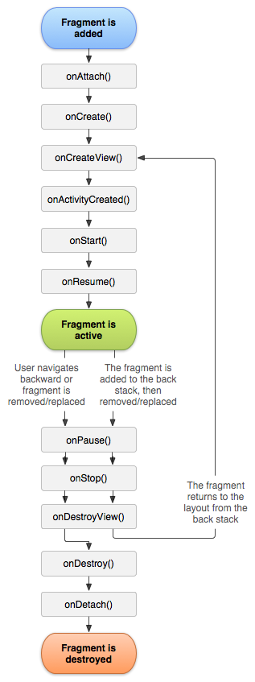
Fragment Lifecycle
Usually, you should implement at least the following lifecycle methods:
onCreate & onCreateView

Slide 40
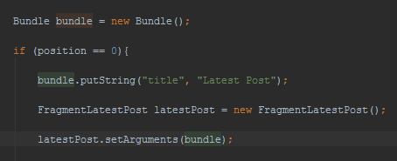
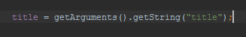
Send and Get Data on Fragment from Activity
If an Activity use Intent for send data, in Fragment we use Arguments

Slide 41
Exercise | Whatsapp Layout

